Slide 1
Health Care System
Università degli Studi di Milano – Dipartimento di Informatica
Sara Cinquini, Mat. 27283A
Course “Simulation” – Exam Project, A.Y. 2023-2024

Slide 2
Table of contents
01
02
03
Introduction
Agents
Implementation
04
05
06
Flow Chart
Experiment
Conclusion
012345678900

Slide 3
Introduction
1

Slide 4
Introduction
This project focuses on analysing the flow and management of patients in a hospital emergency room, addressing key aspects such as
patient influx,
queue management,
resource allocation (nurses and operating rooms),
waiting times.
Using AnyLogic simulation software, it replicates the daily operations of the San Donato Milanese hospital's emergency room over a 24-hour period. The goal is to gain insights into the emergency room's functioning and explore improvements to reduce waiting times and optimize resource allocation, enhancing overall healthcare efficiency.
For this scenario, it was chosen to use a discrete event-based and agent-based simulation model, which has time basis in minutes.

Slide 5
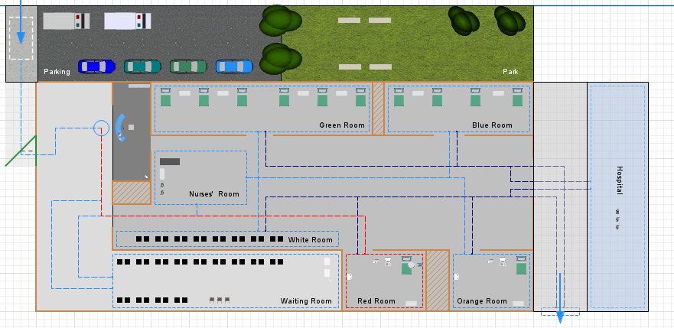
Working flow

Slide 6
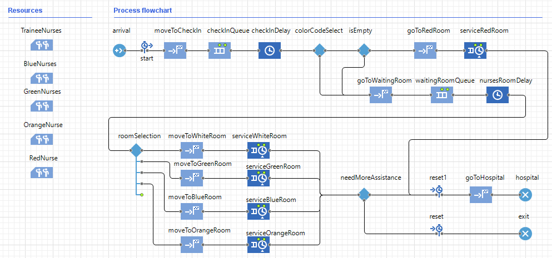
Working flow

Slide 7
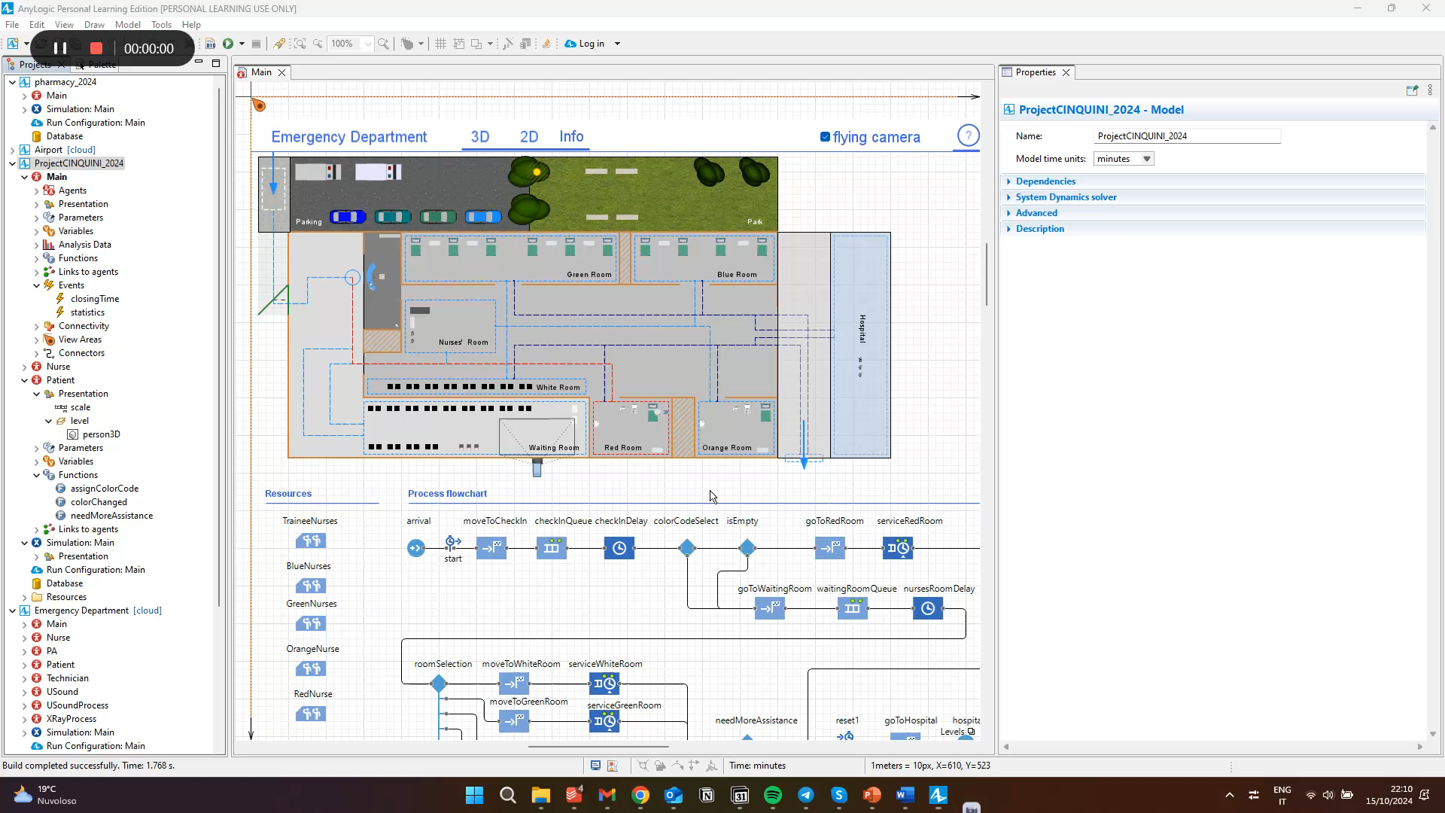
Working flow

Slide 8
Agents
2

Slide 9
Types of agents
012345678900
Agents
This agent-based approach allows for a flexible, realistic simulation of the emergency department, where individual behaviours, and stochastic events combine to influence the system's performance.
Patient
Nurse

Slide 10
Types of Agents - patient
The emergency room of the San Donato Polyclinic in San Donato Milanese manages an average of between 65 and 80 patients per day, so it was chosen to use the value 70 as the starting value for the population.
Each patient has this properties:
Arrival Time | In minutes
Base Priority | According to the color code
Dynamic Priority | To determine the waiting queue
Color COde | Represents the patient’s level of urgency
Rate of Increment | To calculate the patient’s priority

Slide 11
Implementation
3

Slide 12

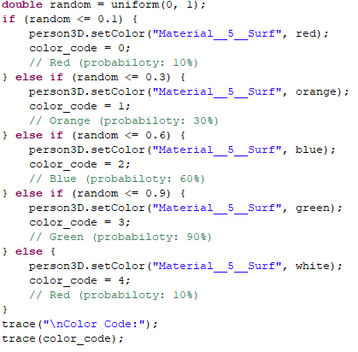
Working flow
Color Codes Assignment
Code that uses probability to assign colour codes to patients.
The uniform(0, 1) function generates a random number with uniform distribution over
[0,1], meaning that each value in that bin has an equal chance of being generated.
The code uses a simple form of cumulative distribution, where the sum of the probability bins covers the entire interval [0,1].

Slide 13
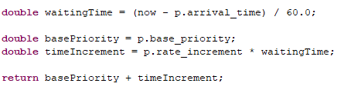
Working flow
Dynamic algorithm for priority
A priority algorithm is used to manage the queue, such that depending on the colour code and the waiting time, the patient will be assigned a priority value.
The idea is to assign each patient a priority score that changes over time, increasing as the waiting time increases. In this way, even less severe patients will be treated sooner or later, as their score will increase enough to surpass them on the list.

Slide 14
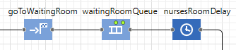
Working flow - Rooms
When the patient is called, he will move from the waiting room to the desk where the nurses are present, who will indicate the correct room in which he will be placed.
In the emergency room there are 5 different rooms, one for each colour code. The capacity depends on the availability of resources in the Emergency Room, in our case:
The red room has a maximum capacity of 1 patient.
The orange room has a maximum capacity of 1 patient.
The blue room has a maximum capacity of 4 patients.
The green room has a maximum capacity of 6 patients.
The white room has a maximum capacity of 15 patients.

Slide 15
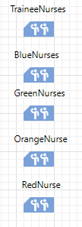
Working flow - Resources
Each room is associated with several nurses who will dedicate themselves to the patients present. Since the codes with higher priority need prompt assistance, it was decided to divide the team as follows:
For orange and red codes, for which the operating room can be occupied by one patient at a time, one nurse is assigned per ward respectively; this allows treatments to be speeded up.
For blue codes, there can be a variable number of nurses ranging from 1 to 4.
For green codes, it was decided to assign a maximum of 3 nurses.
For white codes, the maximum number of residents is 2.

Slide 16
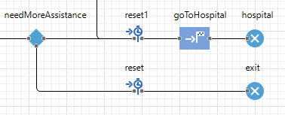
Working Flow - Hospital
Needing more assistance
After, it must be understood whether the problem has been managed or whether it is necessary to keep the patient for longer. Generally, those who hold a code equal to green or white, will end their stay in the emergency room and will be able to go to the exit. If patients have more urgent conditions a further examination will have to be performed to determine whether it is necessary to move them to the appropriate hospital

Slide 17
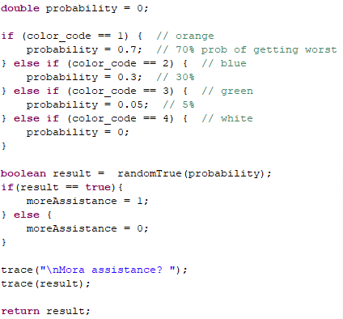
Working Flow - Hospital
Needing more assistance
The code assigns different probabilities for a patient's condition to worsen based on their colour code. The probabilities set are as follows:
Orange code (1): 70% chance of worsening.
Light blue code (2): 30% chance of worsening.
Green code (3): 5% chance of worsening.
White code (4): 0% chance (so never worsens).
This approach reflects the idea that more severe patients have a higher chance of worsening, while less severe patients have a much lower chance, or none. A conditional probabilistic approach was used.

Slide 18
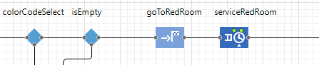
Working flow – Red code
The case in which the patient is a code is treated differently: upon arrival at the reception desk, he will have the highest priority and will be immediately moved to the correct department.
If it is occupied, an attempt will be made to move the patient to the operating room used for patients with orange colour code.
For this reason, a function was created that controls the capacity of the room, in case there is a patient present, the procedure is as follows:
the patient is moved to the waiting room but always keeping the highest property so as to allow him to be the first in the list;
the patient's colour is changed to allow him to go to the orange room.

Slide 19
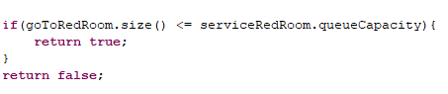
Working code
Red code
The first code reports the control if the red room is occupied: not having a specific queue for the management of red codes (given their urgency) in case the room was previously occupied, an error was obtained in the system. In this way the error is avoided.
As previously mentioned, however, it is necessary to change the patient's colour code while maintaining the same (high) priority.

Slide 20
FlowChart
4

Slide 21
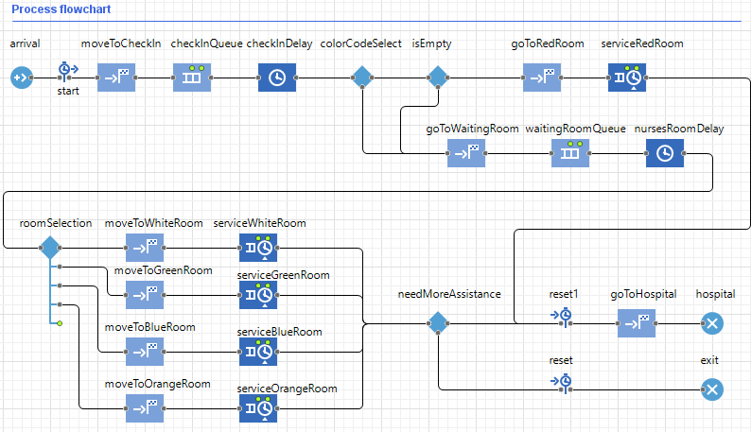

Slide 22
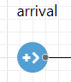
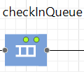
Flowchart
Arrival
Queue, check in
It’s introduced to represent incoming patients in the emergency room. Since patient arrivals are unpredictable, they follow an exponential distribution.
Exponential(0.1, 0)
Using the following exponential distribution, an event will occur every 10 minutes.
Patients in the queue for admission are placed in a queue following FIFO logic. The reason why the logic of colour codes is not followed is that in real hospitals, there must be an initial feedback from the nurse to observe if the urgency is real.

Slide 23
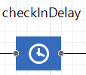
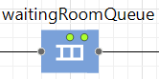
Flowchart
Delay
Waiting room
This delay is intended to simulate admission to the emergency room. As often happens, you have to wait for a certain time, which is why you represent the wait through a triangular variable time distribution .
Each patient is randomly assigned a colour code based on a probability distribution: red (10%), orange (20%), blue (30%), green (40%), or white (default).
To determine the maximum capacity, we considered some factors:
The number of patients who can be treated in nursing rooms
The average treatment time
The Ability of Nurses to Manage Patients
Considering possible subsequent delays, we used a queue with a capacity of 30.
As we said, we use a dynamic algorithm to manage the queue

Slide 24
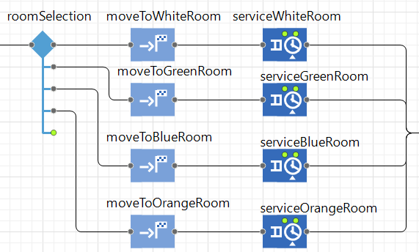
Flowchart
Service Room
Temporal distributions (triangular) were
also used for patient management to
simulate treatment time.
Waiting times differ according to the
complexity of the operation and
treatment, and according to the patient’s
colour code. Therefore, longer waiting
times for higher colour codes may be
observed.

Slide 25
Experiments
5
Python Notebook

Slide 26
KPS & KPI
KPS | KPI
Room Capacity | Average Wait Time
Number of Nurses | % of Patients Trated within an acceptable time
Distribution of Arrivals | Resource Utilization
Priority Management Algorithm | Number of Untreated Patients
In this section we report the Key Parameter of the System and the Key Performance Indicator.
It affects waiting time.

Slide 27
KPS & KPI
KPS | KPI
Room Capacity | Average Wait Time
Number of Nurses | % of Patients Trated within an acceptable time
Distribution of Arrivals | Resource Utilization
Priority Management Algorithm | Number of Untreated Patients
In this section we report the Key Parameter of the Systemb and the Key Performance Indicator.
It determines how quickly the patients are treated.

Slide 28
KPS & KPI
KPS | KPI
Room Capacity | Average Wait Time
Number of Nurses | % of Patients Trated within an acceptable time
Distribution of Arrivals | Resource Utilization
Priority Management Algorithm | Number of Untreated Patients
In this section we report the Key Parameter of the Systemb and the Key Performance Indicator.
An exponential distribution can simulate the variability of arrivals throughout the day.
The exponential distribution was chosen for these reasons:
Poisson processes, allows to have a good approximation of random and independent events, allows to represent the time interval between two consecutive events
Memory less property, patient arrivals do not depend on previous patients

Slide 29
KPS & KPI
KPS | KPI
Room Capacity | Average Wait Time
Number of Nurses | % of Patients Trated within an acceptable time
Distribution of Arrivals | Resource Utilization
Priority Management Algorithm | Number of Untreated Patients
In this section we report the Key Parameter of the Systemb and the Key Performance Indicator.
It balances patient severity with wait time.

Slide 30
KPS & KPI
KPS | KPI
Room Capacity | Average Wait Time
Number of Nurses | % of Patients Trated within an acceptable time
Distribution of Arrivals | Resource Utilization
Priority Management Algorithm | Number of Untreated Patients
In this section we report the Key Parameter of the Systemb and the Key Performance Indicator.
This KPI is crucial for evaluating the efficiency of the system.

Slide 31
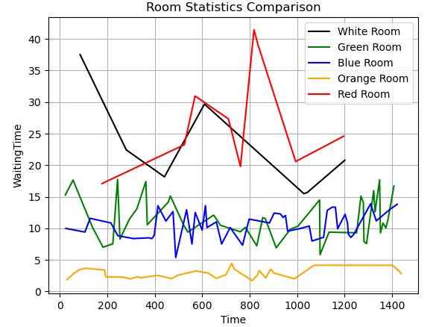
Statistics
Rooms’ comparison
The White room shows a decreasing trend (in the first section) and then has variable peaks. Therefore, during the simulation of 09/10, an increase in demand was visible in the second half of the simulation period.

Slide 32
Statistics
Rooms’ comparison
The Green room has a stable waiting time, with some peaks, but which remains constant for medium-low values. Therefore, it is possible to conclude that the workload was managed efficiently.
The Blue room has stable waiting times, so it was not possible to observe an overload of resources.

Slide 33
Statistics
Rooms’ comparison
The Orange room has low and stable waiting times. There are no different fluctuations, so this is less used but certainly very efficient.
The Red room shows an initial decreasing trend up to a certain point, and then has variable peaks and a rise towards the end of the period. This could indicate an increase in demand in the second half of the simulation period.

Slide 34
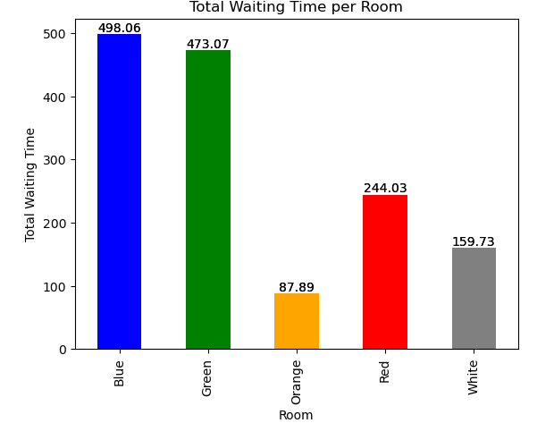
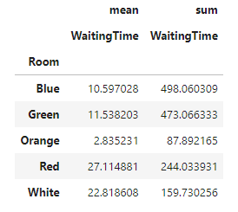
Statistics
Average Treatment Time & Total Room Usage

Slide 35
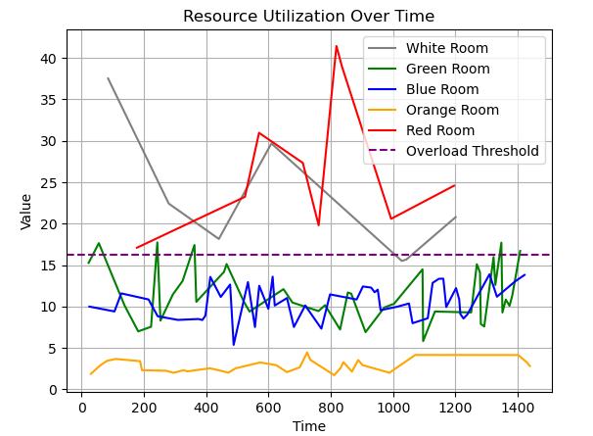
Statistics
Resource Utilization Over Time
In the graph, we clearly see that:
Overload in the White and Red Rooms;
Good management in the Green and Blue Rooms;
Underutilized Orange Room
The overload threshold was equal to
threshold_value = df['WaitingTime'].mean() * 1.5
These results were calculated with a different threshold value, which is the average value for each room.

Slide 36
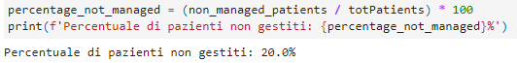
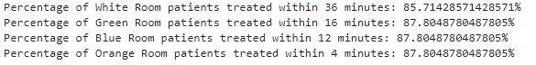
Statistics
% of Untreated Patients
For this calculation, both patients in line for check-in and patients waiting in the waiting room were considered.
By acceptable time, we mean a period of time that is equal to 80% of the maximum waiting time, respectively for each room..
% of Patients treated within acceptable time

Slide 37
Conclusion
6

Slide 38
Conclusions
To further improve the system, you could consider to:
Add more levels of severity in patients to better differentiate critical cases from less urgent ones.
Simulate scenarios with variable patient flows, such as emergencies or peak arrivals, to assess the resilience of the system under stressful conditions.
The simulation model demonstrated its usefulness in providing a detailed picture of the operation of an emergency department, identifying inefficiencies and suggesting potential improvements. Implementing the recommendations provided could lead to reduced waiting times, better use of resources, and ultimately increased efficiency of the healthcare system.

Slide 39
Thanks
Sara Cinquini
Università degli Studi di Milano – Dipartimento di Informatica
Course “Simulation” – Exam Project, A.Y. 2023-2024
01234567890000
Please keep this slide for attribution

